Slide 1
Electric Vehicle Data Analysis
Tableau Dashboard Project Report
Submitted by
Keerthikraj. J

Slide 2
Key Metrics Summary
Total Vehicles: 150,413
Average Electric Range: 67.83 miles
Total BEV Vehicles: 116,745 (77.6%)
Total PHEV Vehicles: 33,668 (22.4%)

Slide 3
Vehicle Trend by Model Year
EV adoption shows strong growth from 2016 onwards.
Peak registrations observed in 2022 and 2023.
Drop in 2024 likely due to partial-year data.

Slide 4
Geographical Distribution
EV registrations are concentrated in a few key states.
States with higher population and EV incentives show higher adoption.
Geographical map visualization highlights regional disparities.

Slide 5
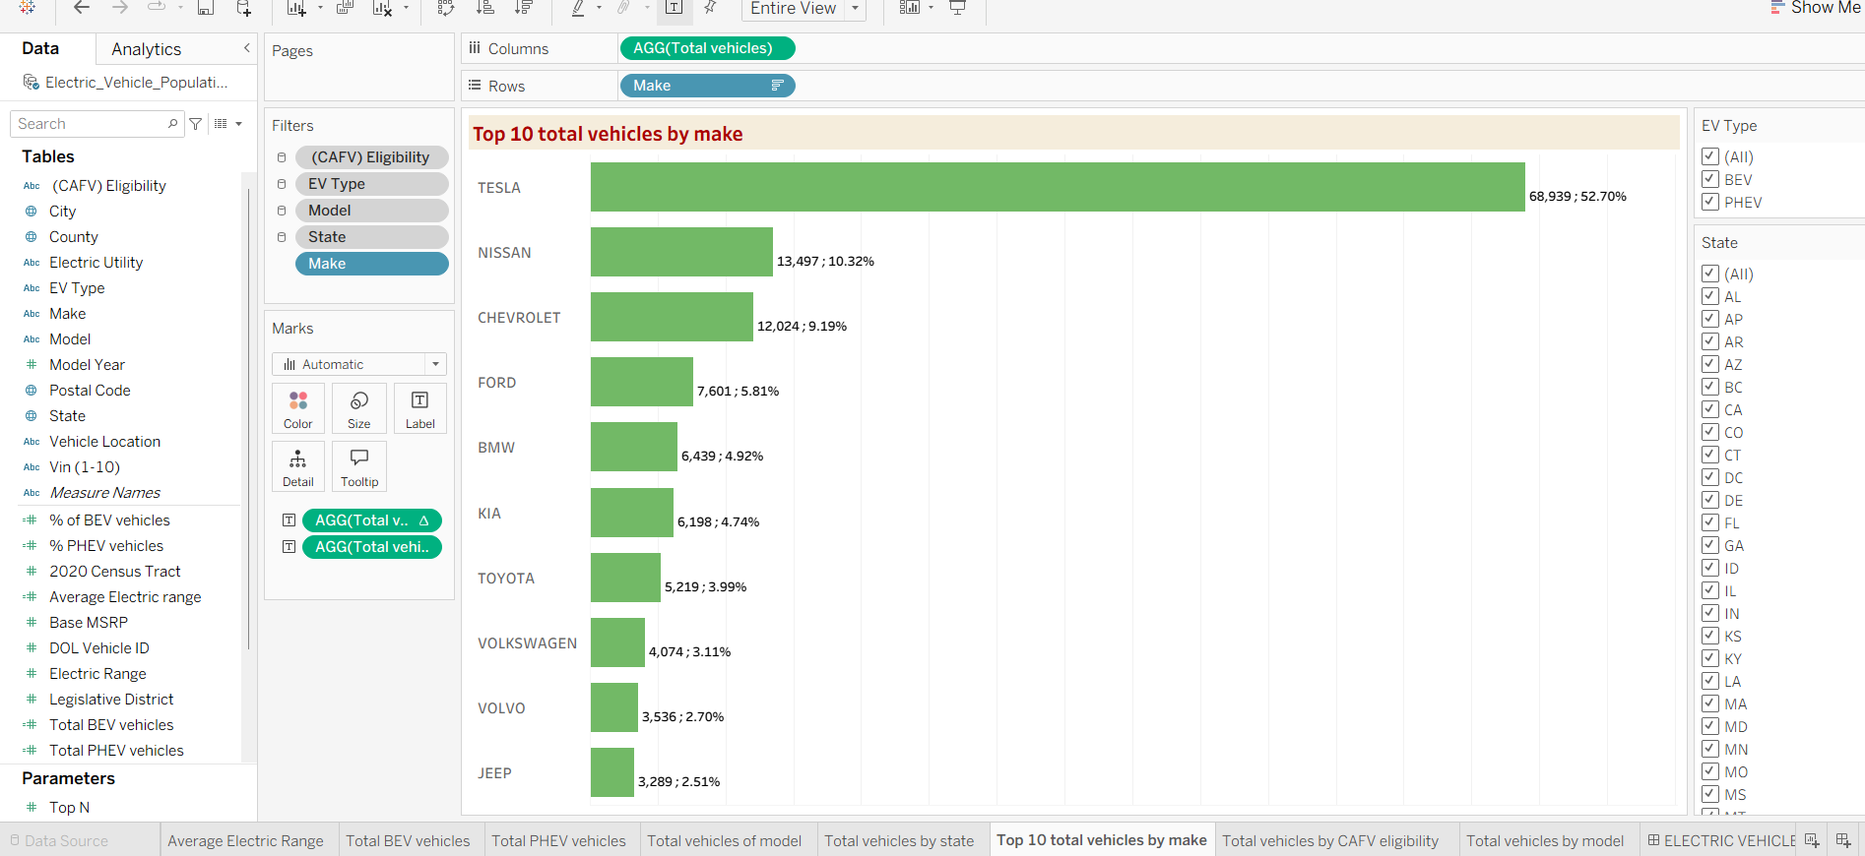
Top EV Manufacturers
Tesla leads the market with over 52% share.
Nissan, Chevrolet, Ford, and BMW follow.
Top 10 manufacturers account for the majority of EV registrations.

Slide 6
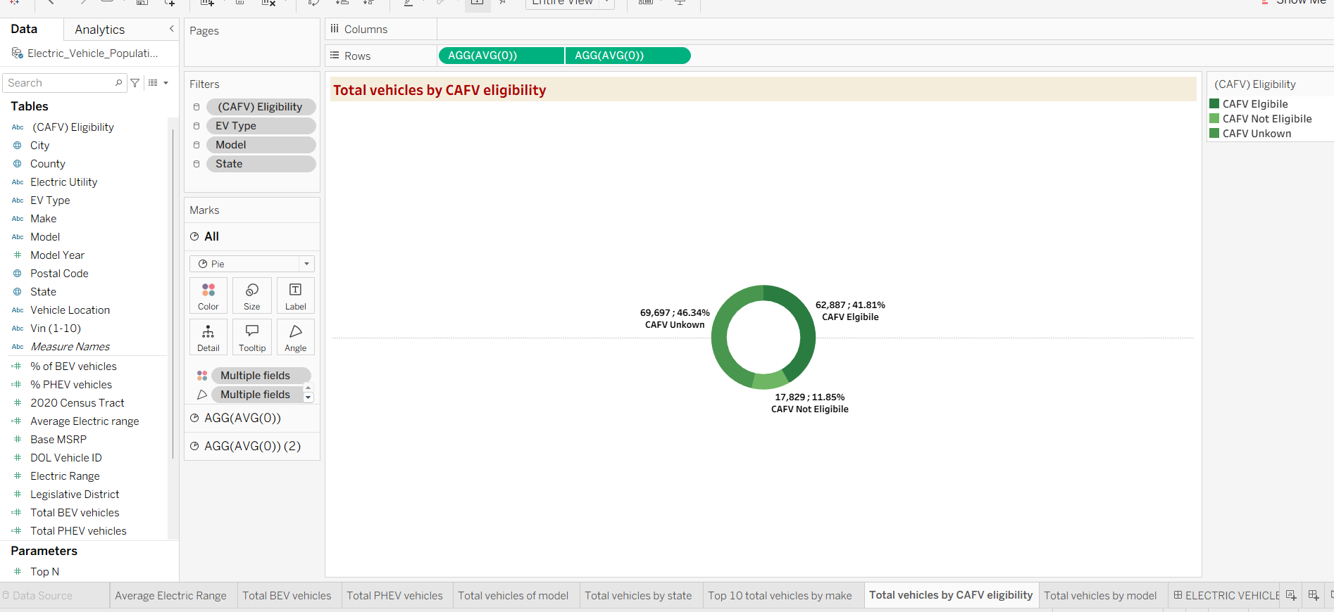
CAFV Eligibility Analysis
41.81% vehicles are CAFV eligible.
11.85% vehicles are not CAFV eligible.
46.34% vehicles have unknown CAFV status.

Slide 7
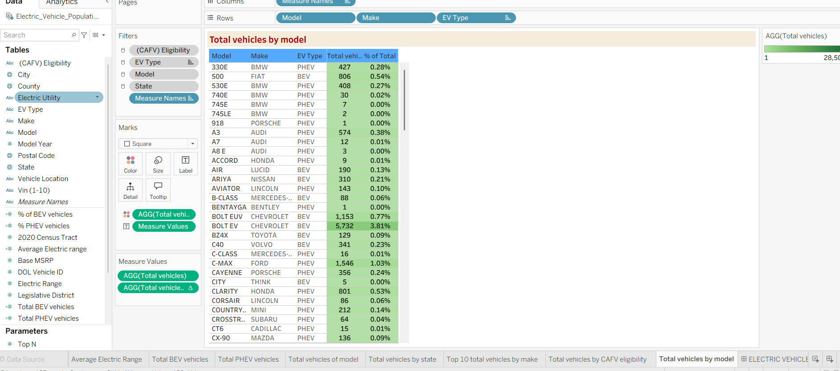
Model-Level Analysis
BMW and Audi dominate the PHEV segment.
Tesla models dominate the BEV category.
Long tail of models with smaller market share.

Slide 8
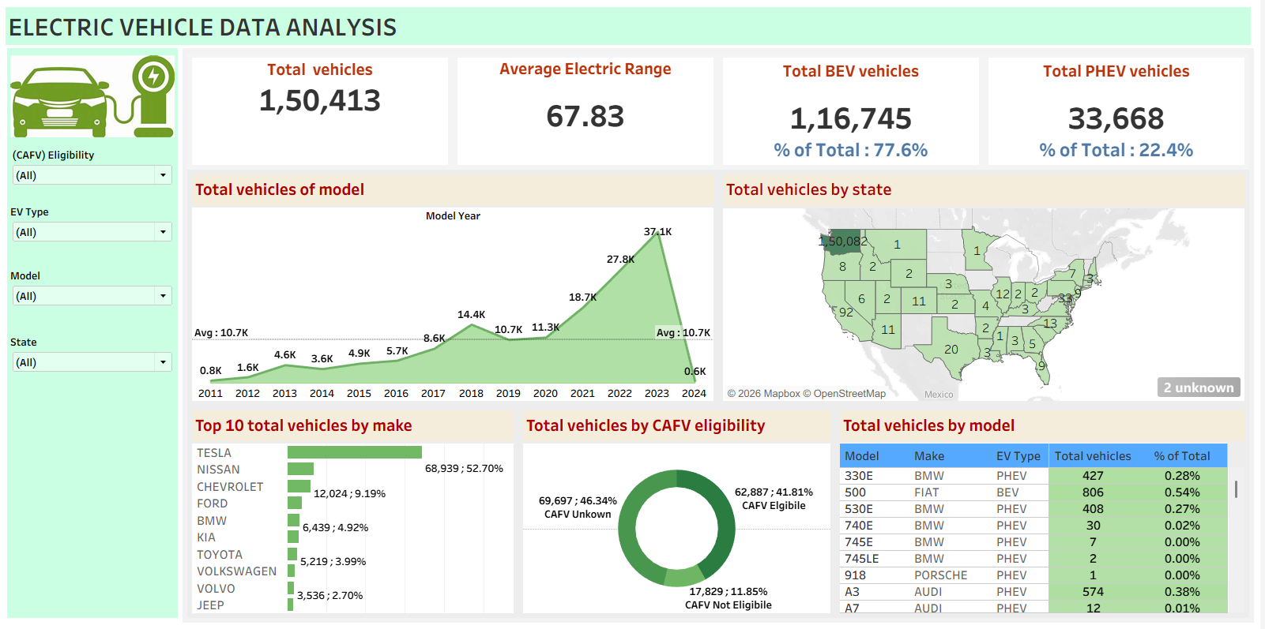
EV Vechicles Data Analysis

Slide 9
Conclusion & Insights
EV adoption is growing rapidly with BEVs as the dominant category.
Manufacturer leadership is concentrated, led by Tesla.
Dashboard enables dynamic filtering by state, model, and EV type.

Slide 10
Thank you

